Slide 1

LIBRARY MANAGEMENT SYSTEM
SUBMITTED TO:-
DR.RAHUL AGGARWAL
SUBMITTED BY:-
AVNEET SINGH SIDHU (21103031)
DEEPANSHU BANSAL (21103044)
GURMAANDEEP SINGH (21103052)

Slide 2
OVERVIEW
System for keeping track of all the outgoing and incoming books to the registered members.
To provide a Friendly environment for maintaining a record of books and library members .
Improve customer service through greater access to accurate information.
Greater accountability and transparency in operations

Slide 3
USER REQUIREMENTS
Provides good graphical interface for the user.
Any administrator can operate on the system, performing the required task such as create , update, viewing the details of the book.
Allows user to view quick reports like book issue/Return etc., In between particular time.
Stock verification in different criteria or according to different –different categories.
Search facility based on different criteria in depth.

Slide 4

NOW, THE PROJECT.....

Slide 5
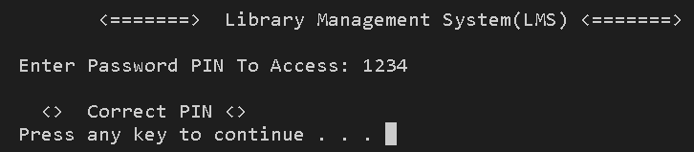
STARTING OFF THE PORTAL BY ENTERING HIGHLY CONFIDENTIALN 4 DIGIT PIN

Slide 6

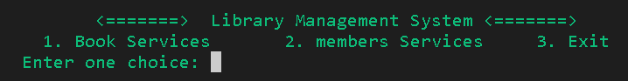
HERE , USER CAN CHOSE EITHER OF THE ONE FACILITY FROM BOOK SERVICES OR MEMBERS SERVICES

Slide 7
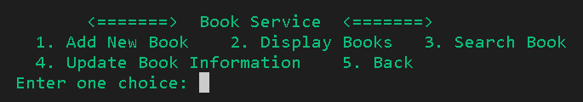
IN BOOK SERVICES SECTION , OPTIONS AVAILABLE ARE
(1) ADDITION OF THE NEW BOOK
(2)DISPLAYING THE LIST OF ALL EXISTING BOOKS
(3)SEARCHING AMONG THE ALREADY ADDED BOOKS
(4)UPDATING THE BOOK BY USING ITS ID NUMBER.

Slide 8

ADDITION OF NEW BOOK TO THE LIST

Slide 9
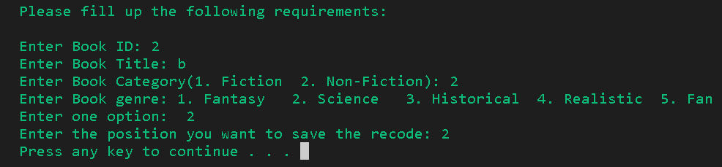
HERE , USER HAS TO INSERT ID OF THE BOOK TO BE ADDED INTO THE LIST.
STEP NUMNBER 1 IS FOLLOWED BY ADDING BOOK’S TITLE.
AFTER SELECTING THE GENRE OF THE BOOK, POSITION NUMBER IS FILLED TO RECODE THE BOOK

Slide 10

DISPLAYING LIST OF ALL THE ADDED BOOKS

Slide 11
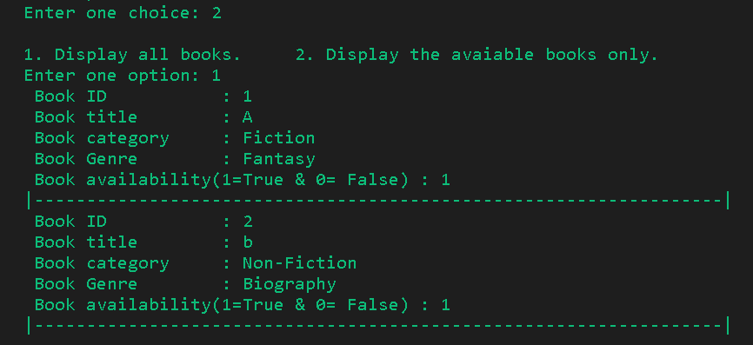
DISPLAYING THE LIST OF ALL BOOKS ADDED TILL THE TIME
HERE , USER HAS THE OPTION TO DECIDE AMONG 2 OPTIONS i.e
DISPLAY ALL OF THE BOOKS OR DISPLAYING THE BOOKS THAT ARE CURRENTLY PRESENT IN THE LIBRARY (BOOKS THAT HAVE NOT BEEN ISSUED)

Slide 12

SEARCHING OF BOOKS

Slide 13
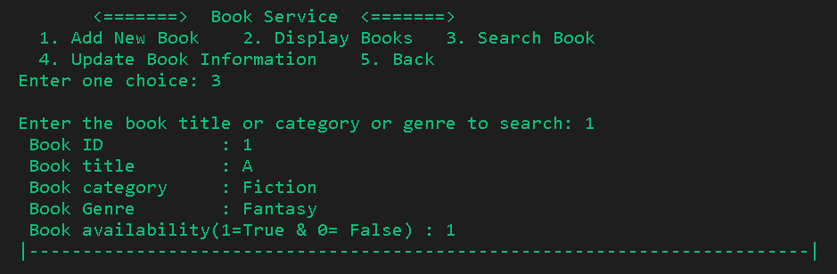
-TO USE THIS FEATURE, USER NEEDS TO KNOW ID AND TITLE OF THE BOOK TO BE SEARCHED PRIOR TO OPENING OF THIS SECTION’S PORTAL
-BOOK AVAILABILITY IS REPRESENTED IN THE TERMS OF TRUE/ FALSE ALONG WITH THE TOTALNUMBER OF BOOKS WOITH SAME ID AND TITLE

Slide 14
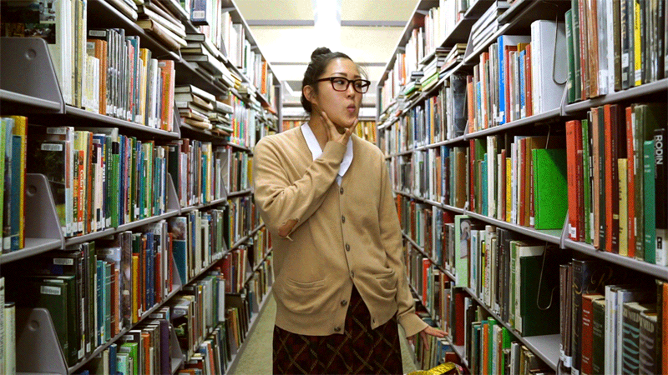
MEMBERS SERVICES

Slide 15
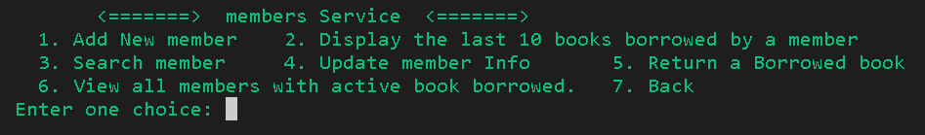
IN THIS SECTION, USER HAS ACCES TO VARIOUS FEATURES SUCH AS:
REGISTERATION OF NEW MEMBER AND PROVIDING UNIQUE ID TO PERSON
GET INFORMATION ABOUT THE BOOKS ISSUED BY THE PARTICULAR MEMBER
SEARCHING OF EXISTING MEMBER BY USING ID PROVIDED TO THE MEMBER WHILE REGISTERATION
DETAILS CAN BE UPDATED BY USING ID
GET THE LIST OF ALL MEMBERS ALONG WITH DETAILS OF BOOKS ISSUED BY THEM

Slide 16
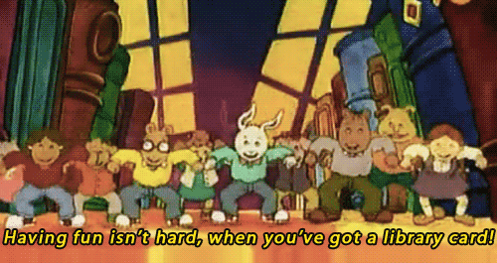
NEW MEMBER REGISTERATION

Slide 17
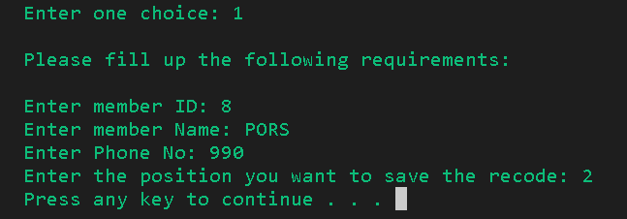
NEW MEMBERSHIP CAN BE ISSUED BY USING ID NUMBER AND NAME OF THE MEMBER . PHONE NUMBER IS ALSO FETCHED FOR MORE ACCURATE AND PRECISE DETAILS ALONG WITH THE SECURITY REASONS

Slide 18

SNEAK PEAK OF OUR CODE

Slide 19
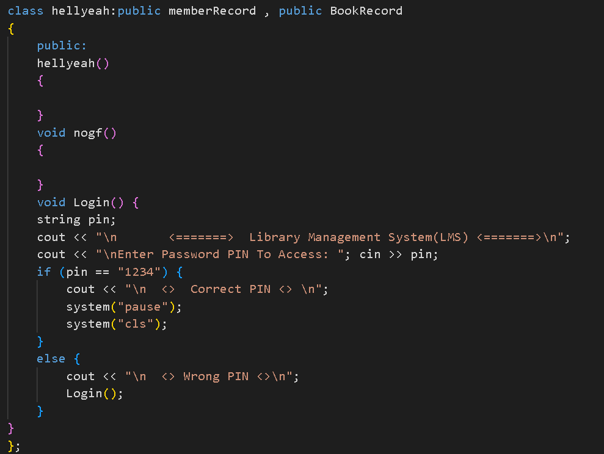
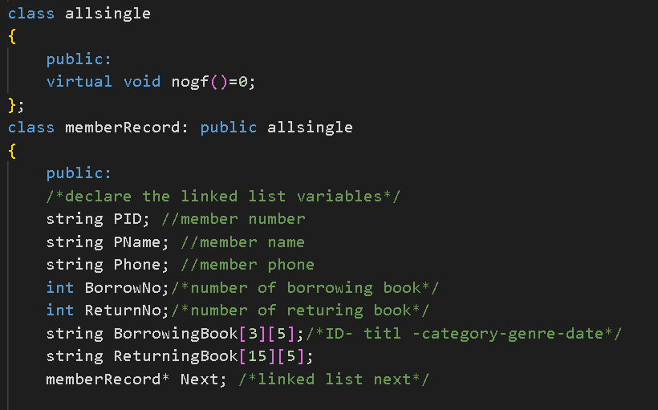
CLASSES USED :-
class allsingle
class memberRecord
class BookRecord
class hellyeah

Slide 20
ABSTRACT CLASS :- class allsingle
PURE VIRTUAL FUNCTION:- virtual void nogf()=0
INHERITANCE:- class memberRecord inherits allsingle
FUNCTION OVERRIDING:- overriding nogf() in memberRecord class

Slide 21
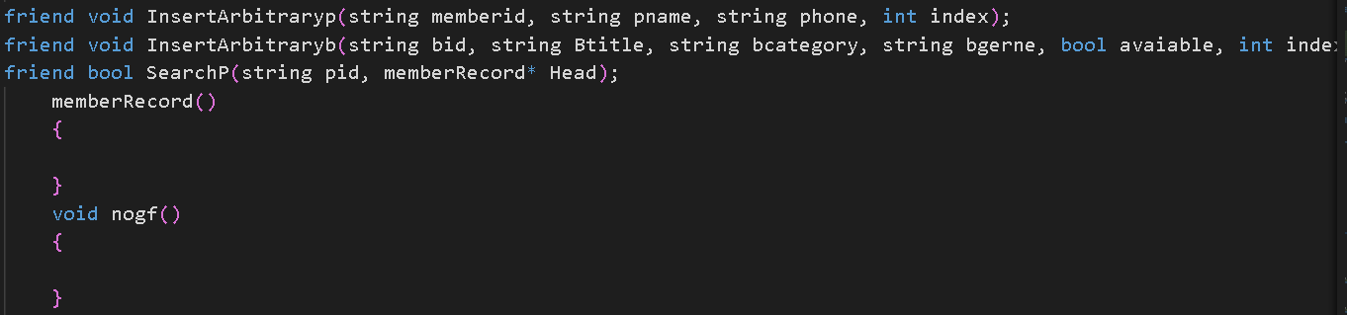
CLASSES USED FRIEND FUNCTIONS:-
insertarbitaryb
insertarbitraryp
searchp

Slide 22
CLASSES USE DIFFERENT TYPES OF INERITANCE:-
MULTIPLE INHERITANCE
MULTI-LEVEL INHERITANCE
HYBRID INHERITANCE
SINGLE LEVEL INHERITANCE

Slide 24
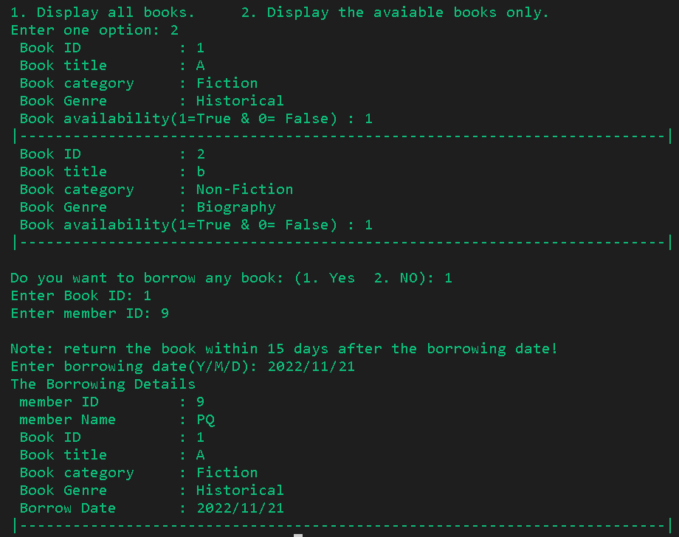
ISSUING OF THE BOOKS
AFTER THE LIST OF ALL AVAILABLE BOOKS PRESENT, USER HAS OPTION TO ISSUE THE BOOK BY ENTERING HIS ID AS WELL AS THE ID NUMBER AND TITLE OF THE SELECTED BOOK.
BORROW DATE ALSO HAS TO BE ADDED AND THE BOOK HAS TO BE RETURNED WITHIN 15 DAYS OF THE DATE OF THE BORROWING.

Slide 25
LIST OF BOOKS BEFORE ISSUING TO THE USER

Slide 26
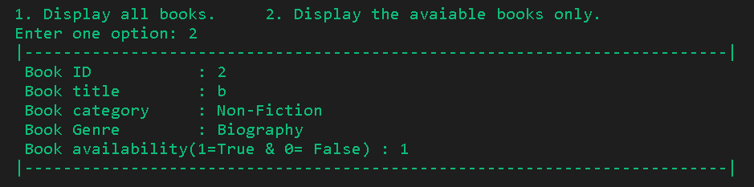
SUPPOSE, THE BOOK ISSUED TO THE USER HAD ID =1
NOW , ONLY BOOK WITH THE ID NUMBER 2 IS AVAILABLE FOR OTHER USERS TO ISSUE.
THE ABOVE IMAGE REPRENTS , LIST OF ALL BOOKS AFTER ISSUING ONE BOOK.

Slide 27
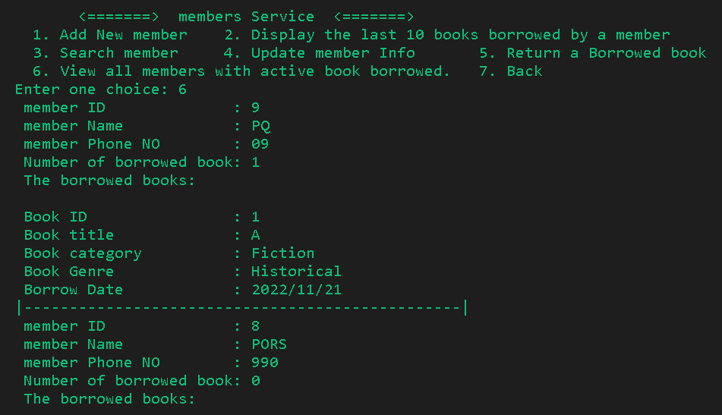
HERE . WE ARE VIEWING , LIST OF ALL MEMBERS ALONG WITH INFORMATION ABOUT THE NUMBER OF BOOKS ISSUED BY THEM
THE ABOVE OUTPUT REPRESNTS THAT BOOK WITH ID 1 WITH ISSUED TO PERSON HAVING ID = 9.

Slide 28
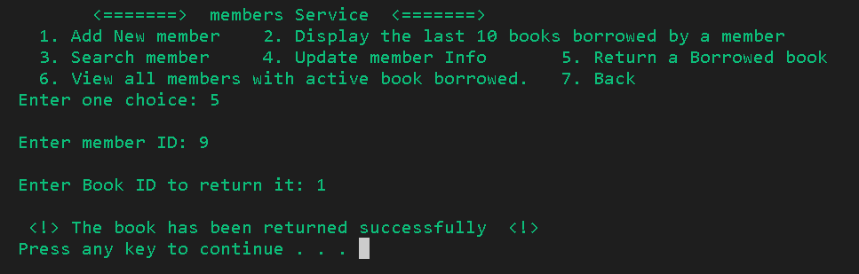
RETURNING OF THE BOOK
BOOK CAN BE RETURNED TO THE LIBRARY BY ENTERING THE ID OF THE BORROWER AND
THE BOOK THAT HAS TO BE RETURNED.

Slide 29
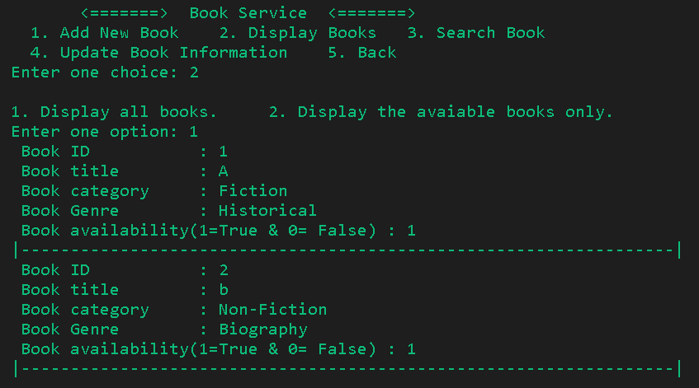
AFTER RETURNING THE BOOK ISSUED BY MEMBER , NOW LIST CONTAINS ALL THE BOOKS THAT
WERE PRESENT IN THE LIBRARY AT STARTING OF THE PORTAL.

Slide 30
ADVANTAGES
A unique ID for both customers as well as books makes it easier to distinguish them from others.
Proper record of all the outgoing books.
Designation of proper id to each member of library so as to avoid any sort of confusion.
Pre-Set password to each system providing full security to the owner of the system.
Classification of books as per their proper type.

Slide 31
THANK YOU

